Slide 1
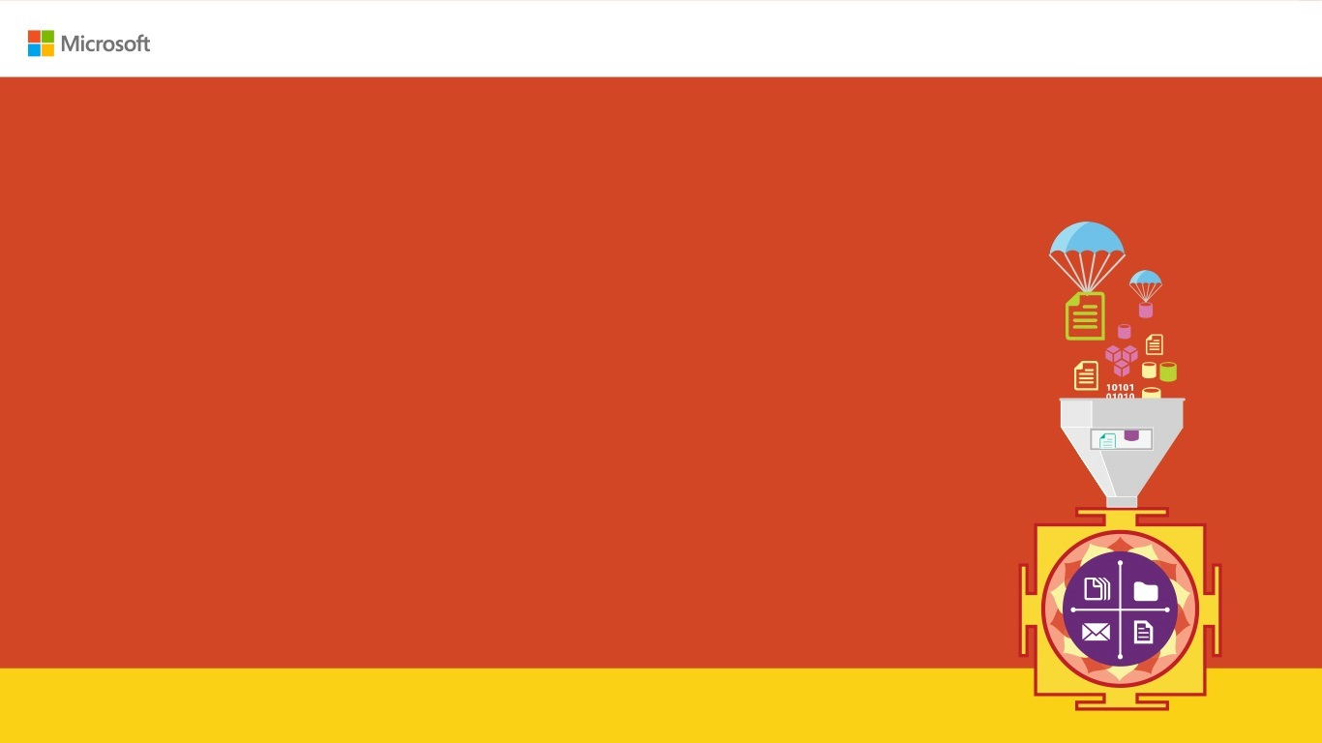

Learn Quantum computing using Q#
Karthikeyan VK
@karthik3030
Karthik_3030@yahoo.com
https://blogs.karthikeyanvk.in

Slide 2

Why Quantum Computing ?
Enter Text
Model complicated chemical reactions
Solves hunger problem.
Build more complex crypto keys(also break crypto keys)
https://blogs.karthikeyanvk.in

Slide 3
Why Quantum Computing ?
Enter Text
Medicine for Deadly Diseases which has no cure.
Solves Global Warming
Solve Sales Problem
https://blogs.karthikeyanvk.in

Slide 4
Why should developer care about Q-Computing ?
Enter Text
Way of Computing Changes
Programming Paradigm changes
https://blogs.karthikeyanvk.in

Slide 5
What is Quantum Mechanics?
Enter Text
Physics that governs the bigger object does not hold for smaller elements such as photons, electrons etc. So new type of physics was devices called as quantum mechanics
https://blogs.karthikeyanvk.in

Slide 6
What is Quantum computing?
Enter Text
Quantum computing is the use of quantum-mechanical phenomena such as superposition and entanglement to perform computation.
https://blogs.karthikeyanvk.in

Slide 7
Basics of Current Computing
Enter Text
Information are saved in bits
State is either 1 or 0
Current on or Current off
https://blogs.karthikeyanvk.in

Slide 8
Basics of Quantum Computing
Enter Text
Information are saved in qubits
State is both 1 or 0, until observed
Spin up and Spin down
https://blogs.karthikeyanvk.in

Slide 9
Basics of Quantum Computing
Enter Text
Current Computing | Quantum Computing
Information are saved in bits | Information are saved in qubits
State is either 1 or 0 | State is both 1 or 0, until observed
State is saved in Transistor | State in saved in Photons, electrons, atom.
Current on or Current off | Spin up and Spin down
https://blogs.karthikeyanvk.in

Slide 10
Quantum Computing
Enter Text
Superposition
Entanglement
Interference
https://blogs.karthikeyanvk.in

Slide 11
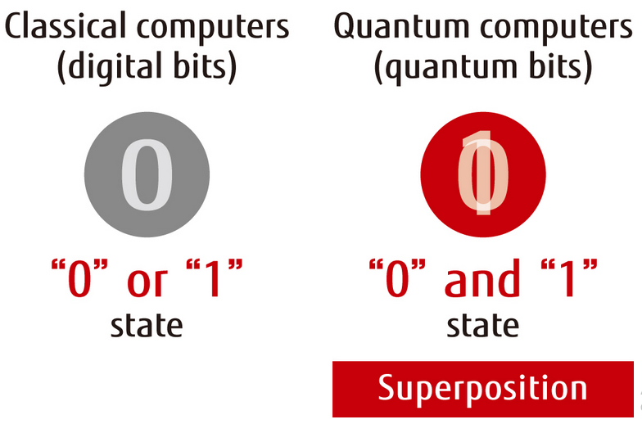
Current Computing Vs Quantum Computing
Enter Text
https://blogs.karthikeyanvk.in
Notes:
Just remember qubits can save both states.

Slide 12
Enter Text
Demo on Q#
https://blogs.karthikeyanvk.in

Slide 13
Qubits
Enter Text
Qubit is the basic unit of quantum information
A qubit is a two-state (or two-level) quantum-mechanical system
It is made of Single Photon, Electron or nucleus
https://blogs.karthikeyanvk.in
Notes:
Just remember qubits can save both states.

Slide 14
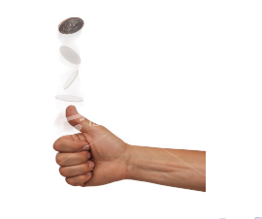
Understanding Qbit State
Enter Text
https://blogs.karthikeyanvk.in

Slide 15
Understanding Qbit State
Enter Text
Heads | Tails
1 | 0
 | Result
Heads | 50%
Tails | 50%
https://blogs.karthikeyanvk.in

Slide 16
Coins spins for 5 Times
Enter Text
Heads | Tails
1 | 0
 | Value
1st spin | 1
2nd spin | 0
3rd spin | 1
4th spin | 0
5th spin | 1
https://blogs.karthikeyanvk.in

Slide 17
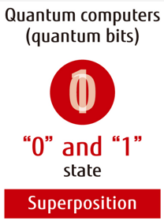
Coins spins for 5 Times
Enter Text
 | Value
1st spin | 1
2nd spin | 0
3rd spin | 1
4th spin | 0
5th spin | 1
https://blogs.karthikeyanvk.in

Slide 18
Quantum superposition
Enter Text
Any two (or more) quantum states can be added together ("superposed") and the result will be another valid quantum state
https://blogs.karthikeyanvk.in
Notes:
"hidden variable" theory

Slide 19
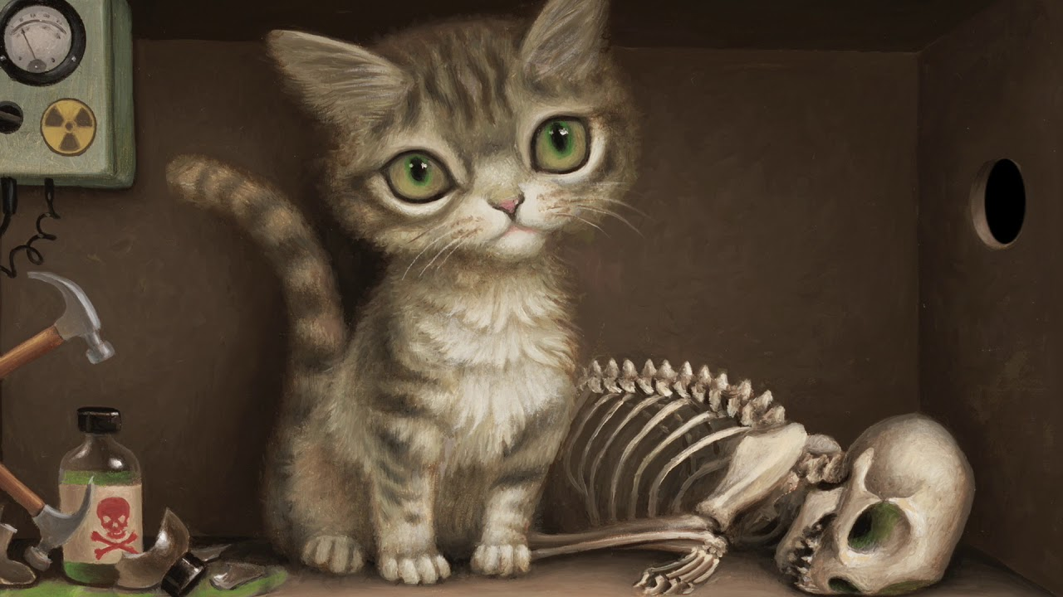
Quantum superposition – Schrödinger's cat
Enter Text
https://blogs.karthikeyanvk.in

Slide 20
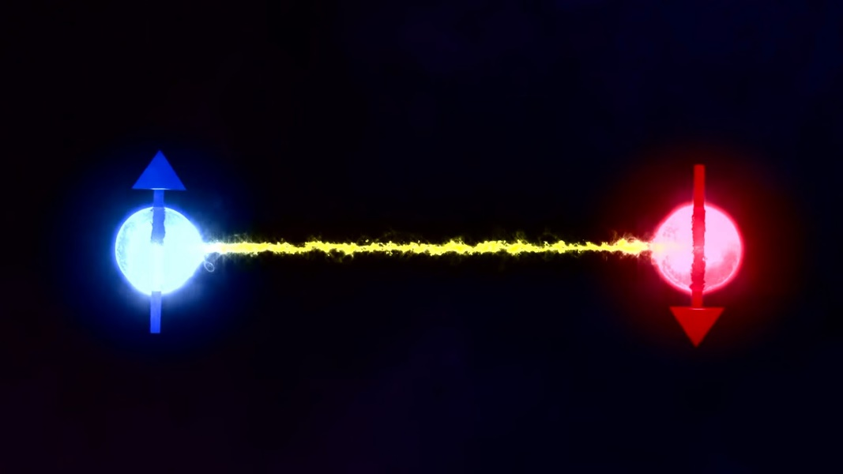
Quantum Entanglement
Enter Text
In quantum physics, entangled particles remain connected so that actions performed on one affect the other, even when separated by great distances.
https://blogs.karthikeyanvk.in
Notes:
"hidden variable" theory

Slide 21
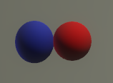
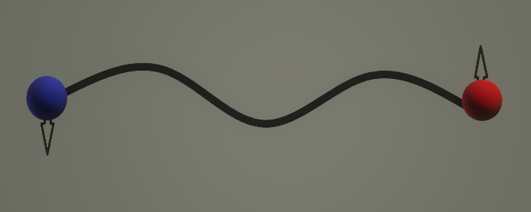
Quantum Entanglement
Enter Text
Affects the behaviour
Contact Once
https://blogs.karthikeyanvk.in
Notes:
"hidden variable" theory

Slide 22
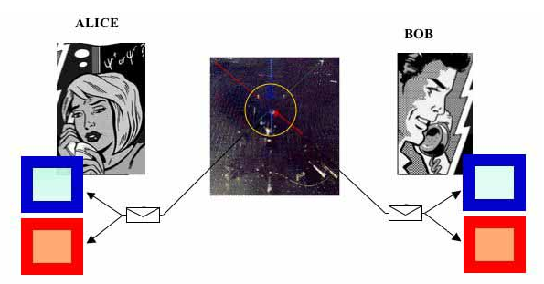
Bells Test
Enter Text
https://blogs.karthikeyanvk.in

Slide 23
Enter Text
Demo on Bell Test
https://blogs.karthikeyanvk.in

Slide 24
Enter Text
References
https://towardsdatascience.com/demystifying-quantum-gates-one-qubit-at-a-time-54404ed80640
https://docs.microsoft.com/en-us/azure/azure-functions/durable-functions-install
https://blogs.karthikeyanvk.in
@karthik3030

Slide 25
Enter Text
Thank you /Q&A
https://blogs.karthikeyanvk.in
@karthik3030

